Slide 1

Presented By : Yashvi Modi SPID:2019026228
Rampat Varma SPID:2019026270
Mohammad Vohra SPID:2019026271
Guided By : Dr. Darshna Rajput
Group No : 21

Slide 2
INTRODUCTION
“Travel is the main thing you purchase that makes you more extravagant”. We, at 'Staycation’, swear by this and put stock in satisfying travel dreams that make you perpetually rich constantly.
We have been moving excellent encounters for a considerable length of time through our cutting-edge planned occasion bundles and other fundamental travel administrations. We rouse our clients to carry on with a rich life, brimming with extraordinary travel encounters.
Here we present our group project, STAYCATION

Slide 3
PROJECT GOAL
This website provides web based system that allows admin to manage online Tours and travels management of different places.
Admin can manage different category, sub-category and different packages.
Customer can view and Book the packages and transportation as well.
Main aim is to let people book their packages with an ease

Slide 4
OBJECTIVE
Admin
Admin can login and then manage different category.
Admin can manage different sub-category.
Admin can manage different packages.
Admin can logout.
Customer
Customer can registration.
Customer can login and view packages as well book tickets online.
Customer can book the places.
Customer can view the payment details.
Customer can logout.

Slide 5
SCOPE OF PROJECT
Our website can be accessed by anyone at anytime from anywhere.
Only admin and registered customers can login into our site.
We are handling all our activities online.
We have created this website so that it becomes much easy for the customers to book the packages anywhere.

Slide 6
SYSTEM ENVIRONMENT
Hardware Requirement
Processor: Intel Core i3
Hard Disk: 1 TB
RAM: 4 GB
Software Requirement
WAMP Server: 2.4
APACHE Version: 2.4.4
MYSQL: 5.6.12

Slide 7
PLATFORM ENVIRONMENT
Front End Used: PHP
PHP stand for Hypertext pre-processor.
PHP is general purpose scripting language that is especially suited to server-side web development, in which case php generally runs on a web server.
Back End Used: MYSQL
MYSQL is a database system used by many websites on the internet.
MYSQL is world’s most popular open source database.
It can be easily installed in all major operation system like Microsoft, Windows, Linux, Unix.

Slide 8
SYSTEM REQUIREMENT ANALYSIS
Two Modules:
Admin
Customer

Slide 9
ADMIN
Login:
Admin can login
Manage Category:-
Admin can manage category
Manage package details
Admin can manage packages detail.
Manage Booking
Admin can manage the booking of several places.
View New Bookings
Admin can view the New bookings done by the customers.
Manage Users
Admin can manage users
Manage pages
Admin can change content of the pages

Slide 10
CUSTOMER
Registration
Customer can registration in website.
Login
Customer can login using registered email id and password.
View Packages
Customer can view the packages.
Place Bookings
Customer can book the Places.
Booking E-Tickets.
Customer can book e-tickets online.
Booking History
They can view the old booking in order history.
Logout
They can logout.

Slide 11
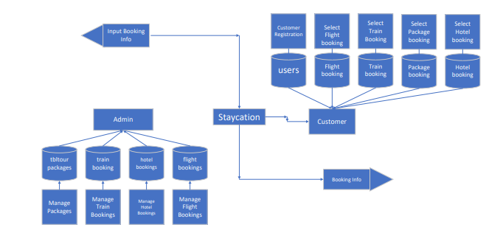
SYSTEM FLOW DIAGRAM

Slide 12
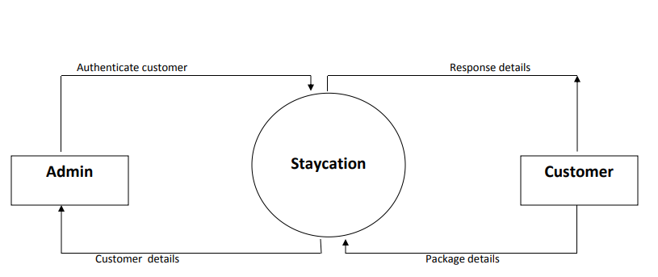
ZERO LEVEL DFD

Slide 13
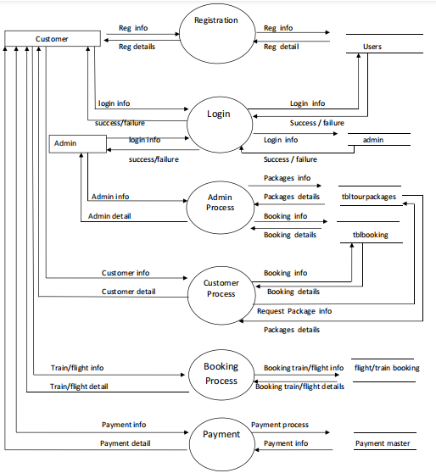
FIRST LEVEL DFD

Slide 14
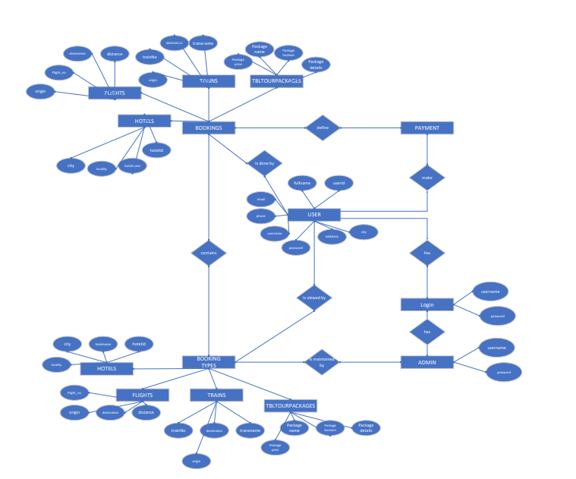
ER DIAGRAM

Slide 15
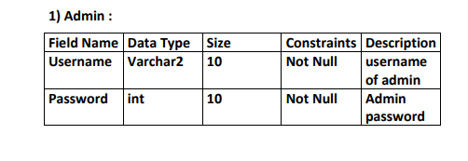
DATA DICTIONARY

Slide 16
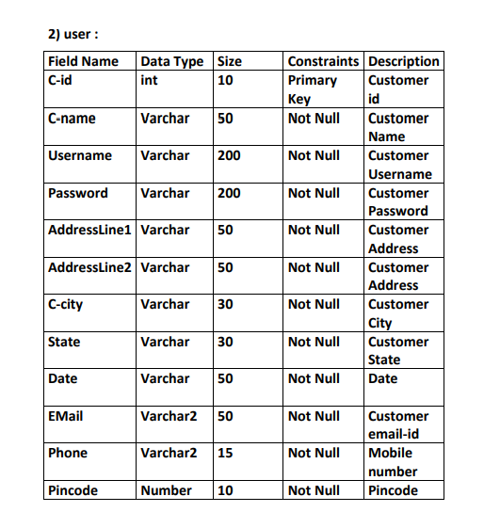

Slide 17
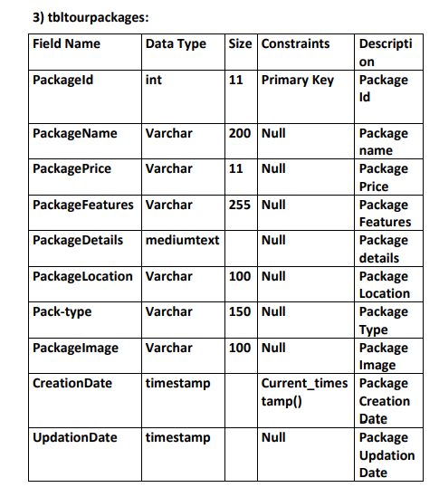

Slide 18
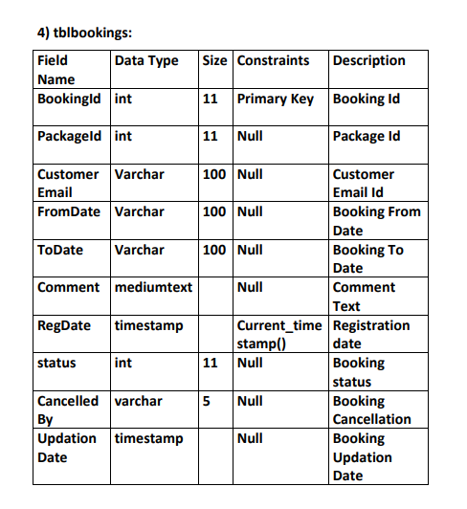

Slide 19
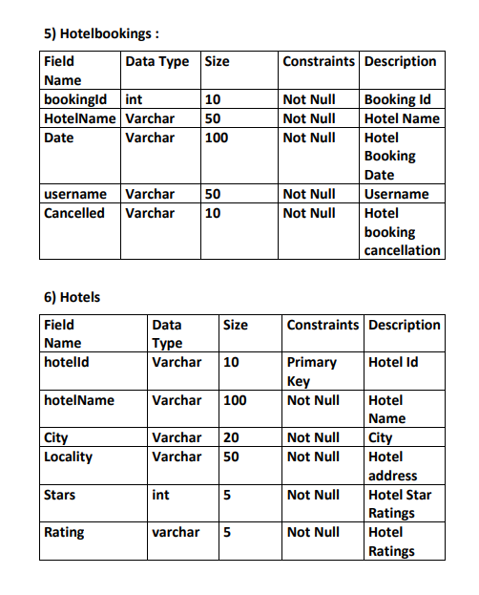

Slide 20
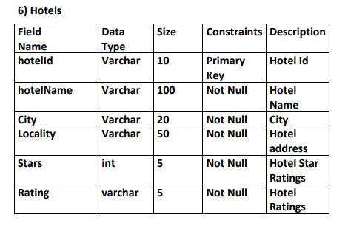
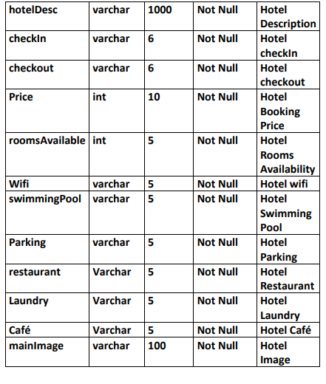

Slide 21
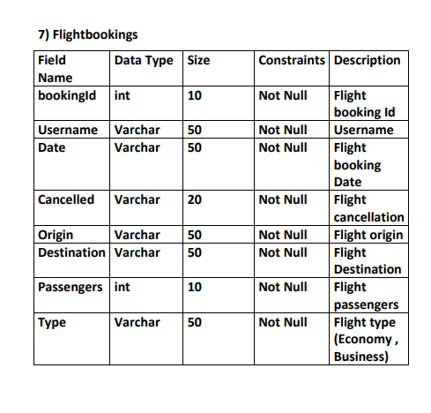

Slide 22
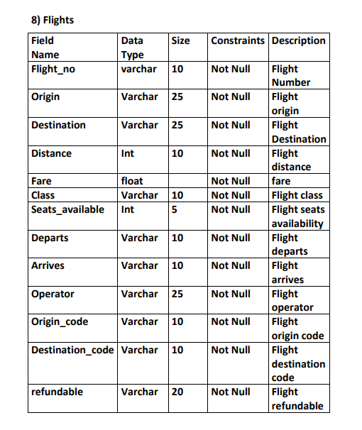
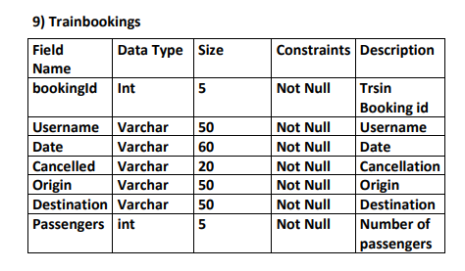

Slide 23
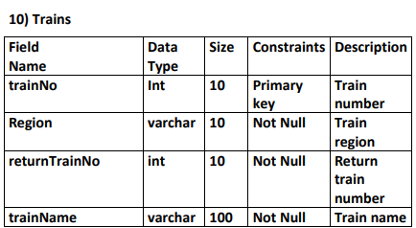
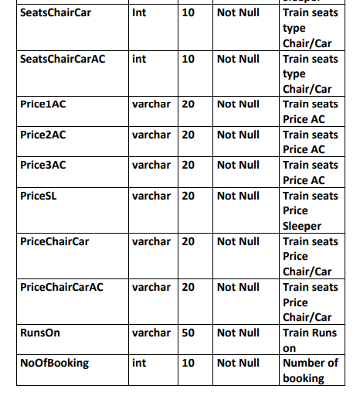
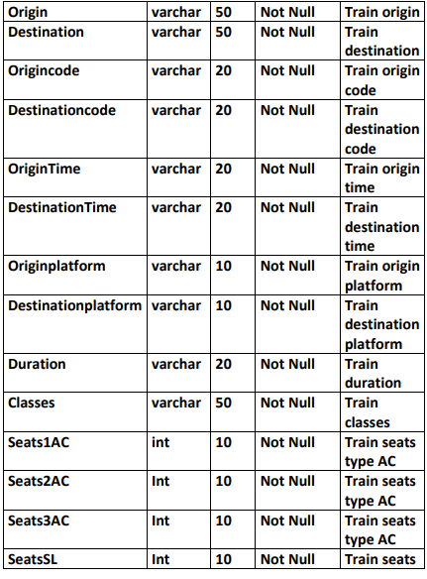

Slide 24
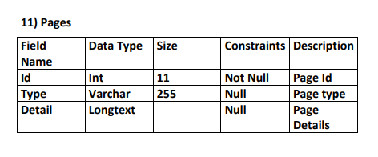

Slide 25
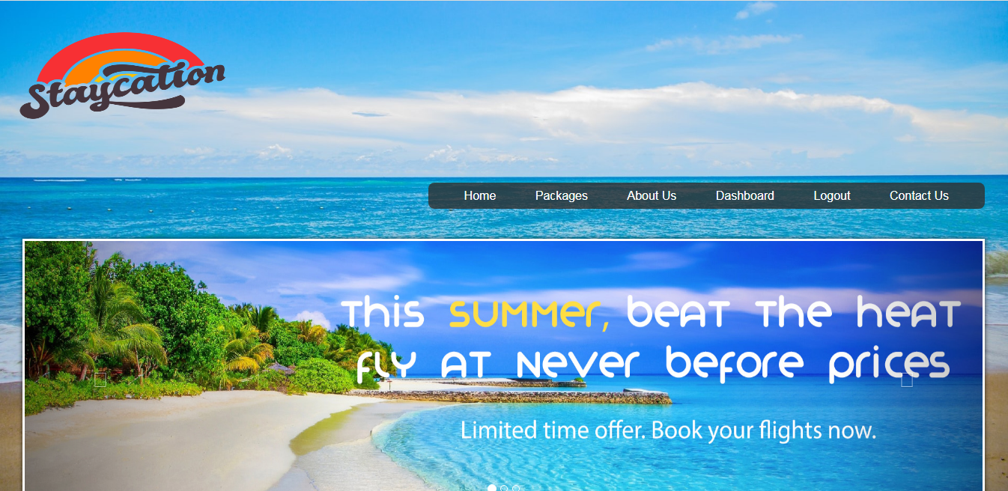
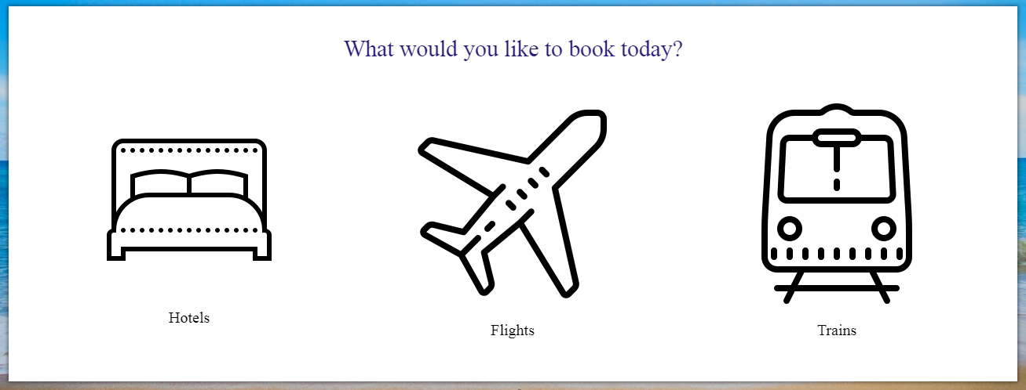
HOMEPAGE

Slide 26
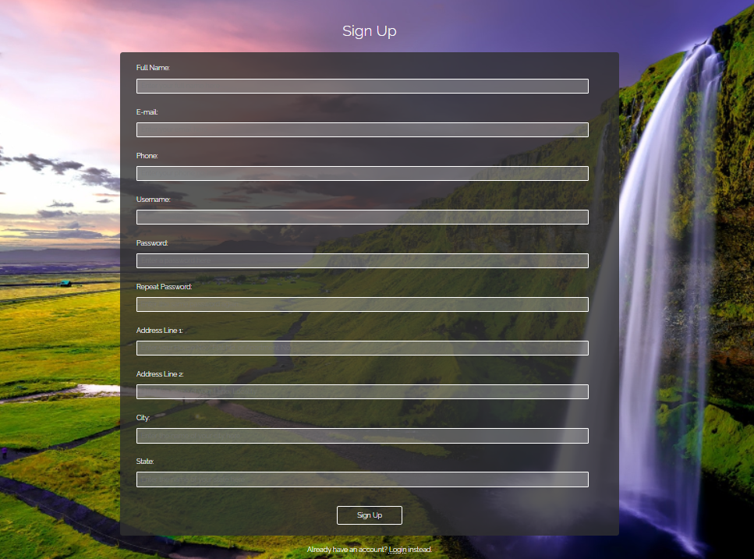
USER REGISTRATION

Slide 27
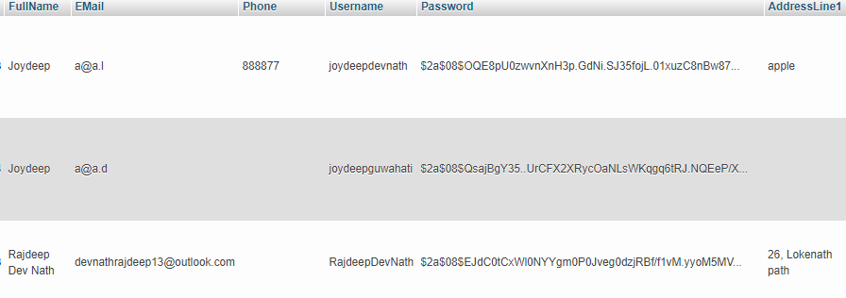
USER ENCRYPTED PASSWORD SYSTEM
Original Password : 0000
Encrypted Password :
Database : users

Slide 28
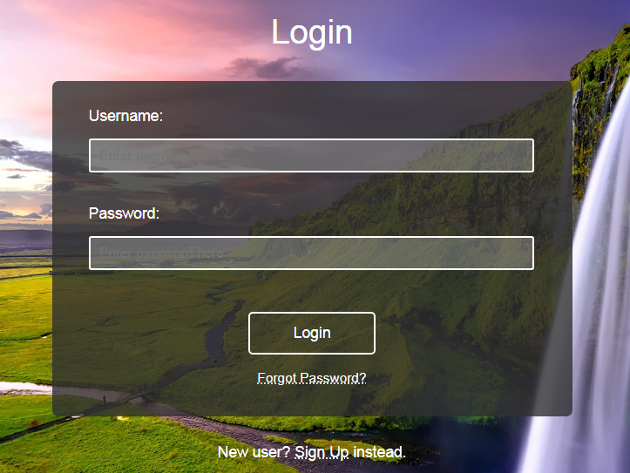
USER LOGIN

Slide 29
TRAIN BOOKING

Slide 30
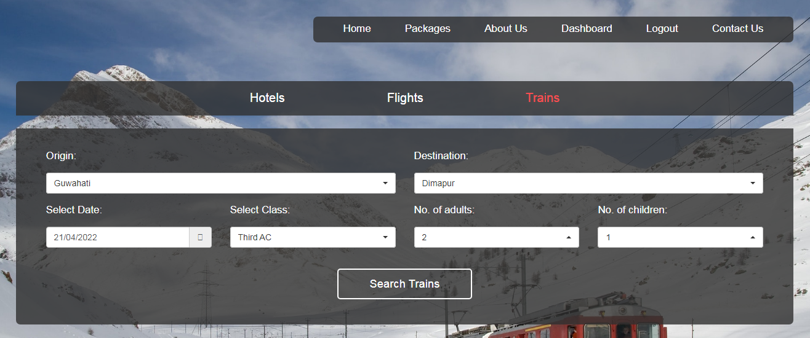
TRAIN BOOKING PROCESS

Slide 31
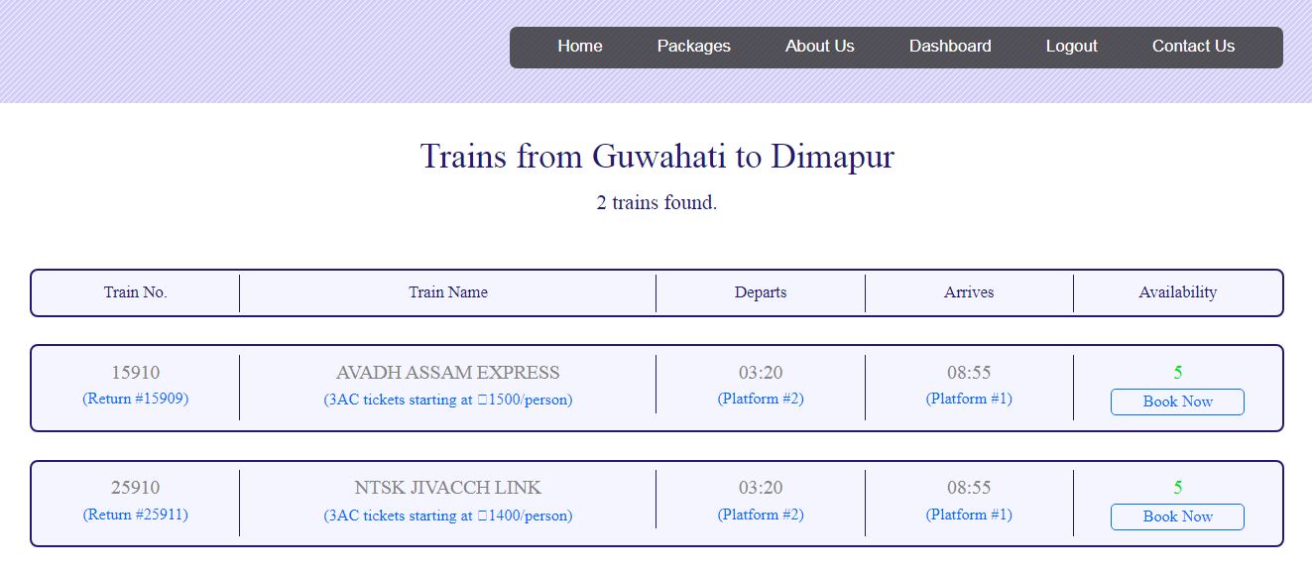
TRAIN AVAILABILITY

Slide 32
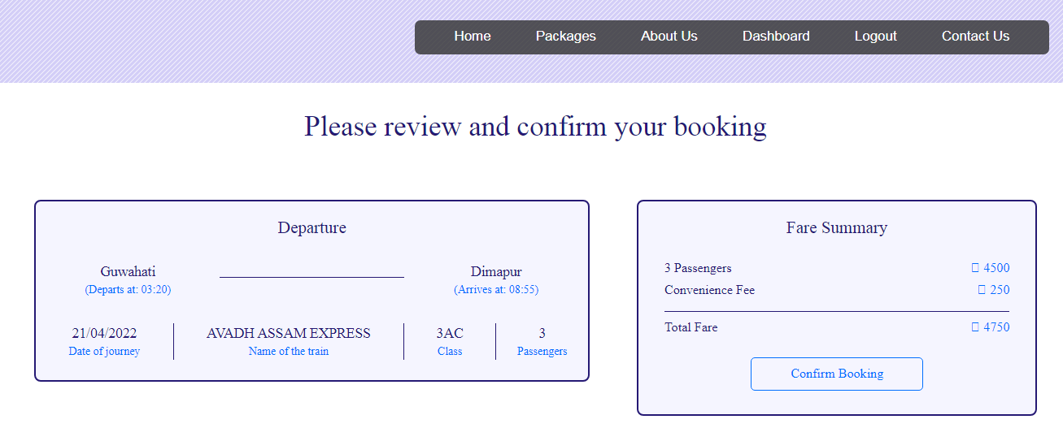
CONFIRM TRAIN BOOKING PROCESS

Slide 33
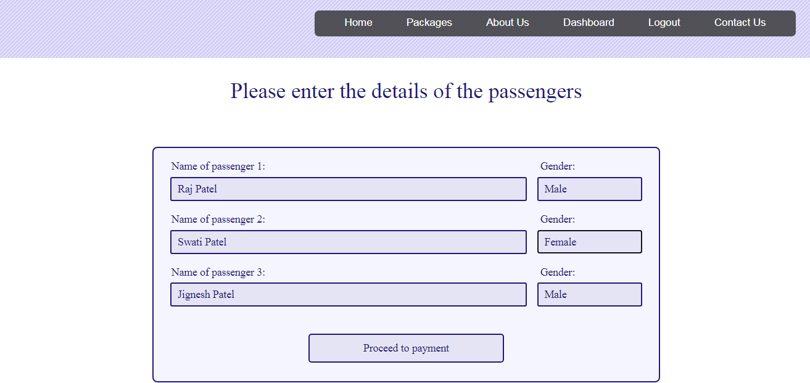
PASSENGERS DETAILS

Slide 34
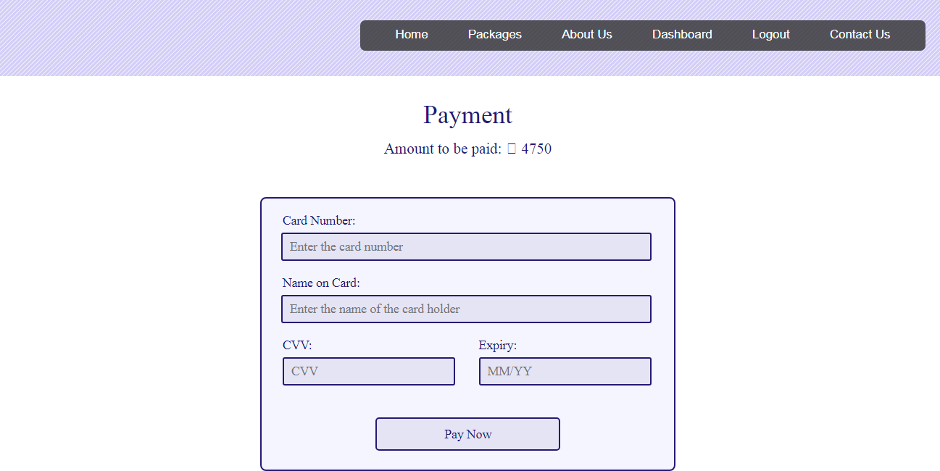
PAYMENT PROCESS

Slide 35
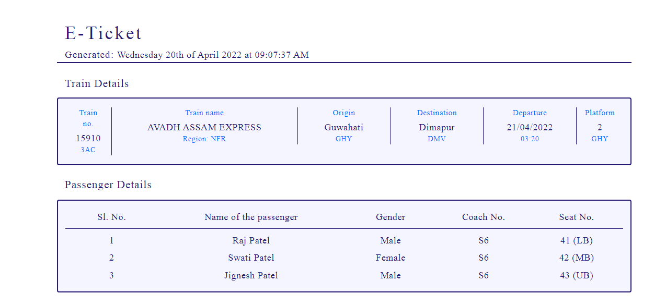
E-TICKET OF TRAIN BOOKING

Slide 36
FLIGHT BOOKING

Slide 37
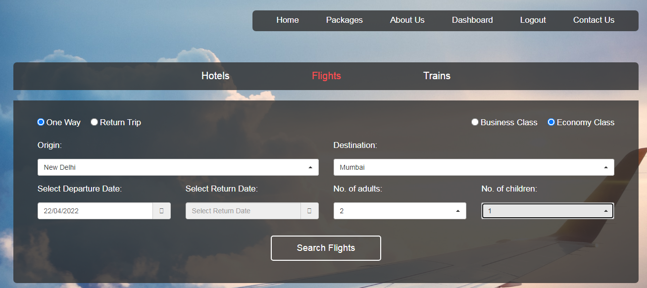
FLIGHT BOOKING PROCESS

Slide 38
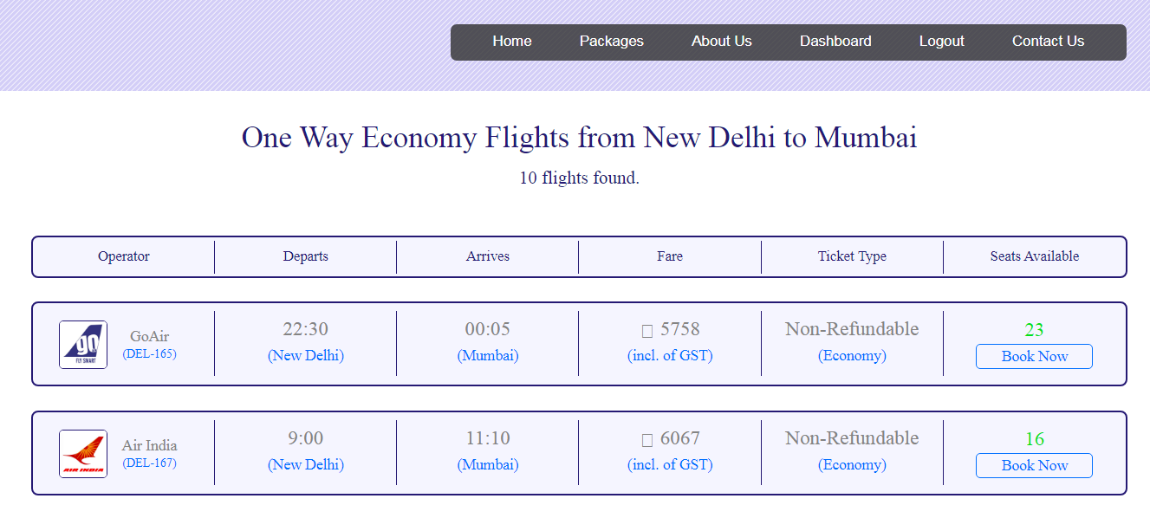
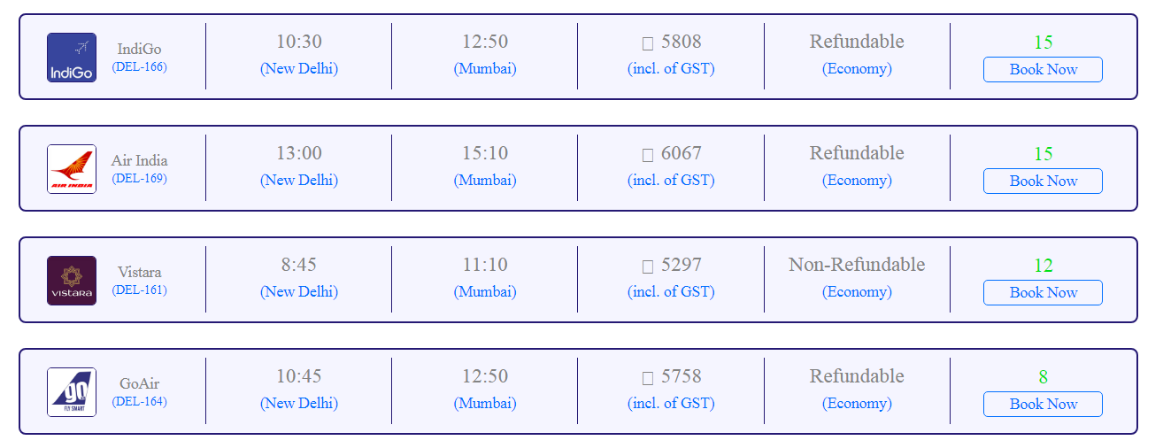
FLIGHTS AVAILABILITY

Slide 39
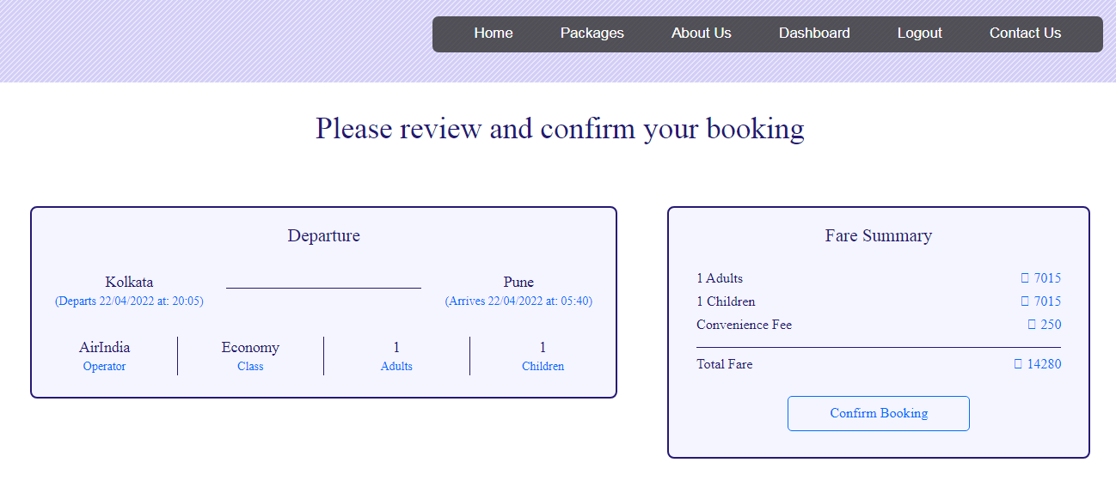
CONFIRM BOOKING OF FLIGHT

Slide 40
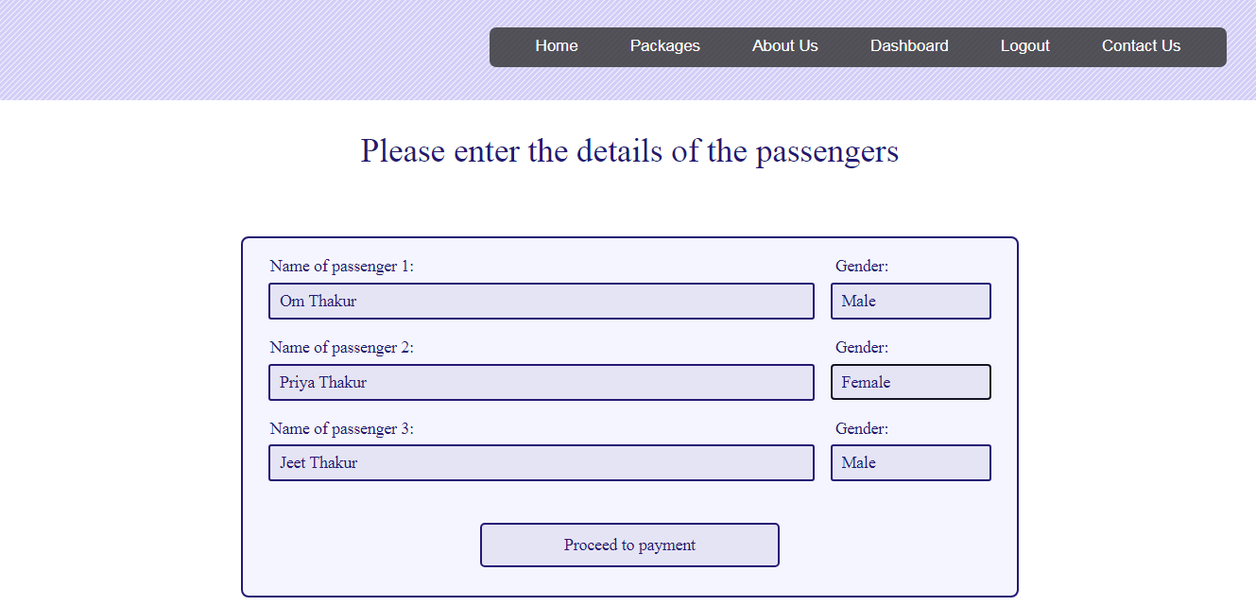
PASSENGERS DETAILS DURING BOOKING

Slide 41
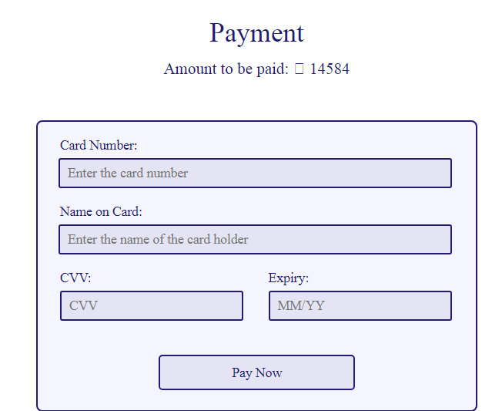
PAYMENT PROCESS

Slide 42
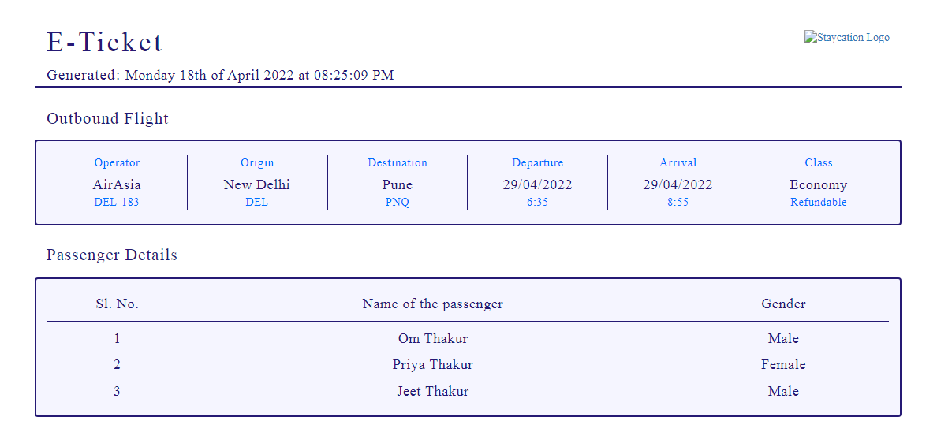
E-TICKET OF FLIGHT BOOKING

Slide 43
HOTEL BOOKING

Slide 44
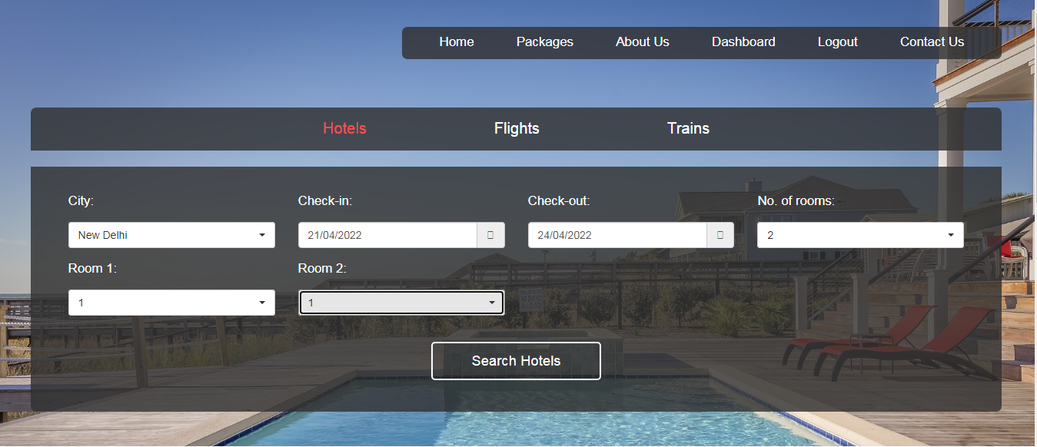
BOOKING HOTELS

Slide 45
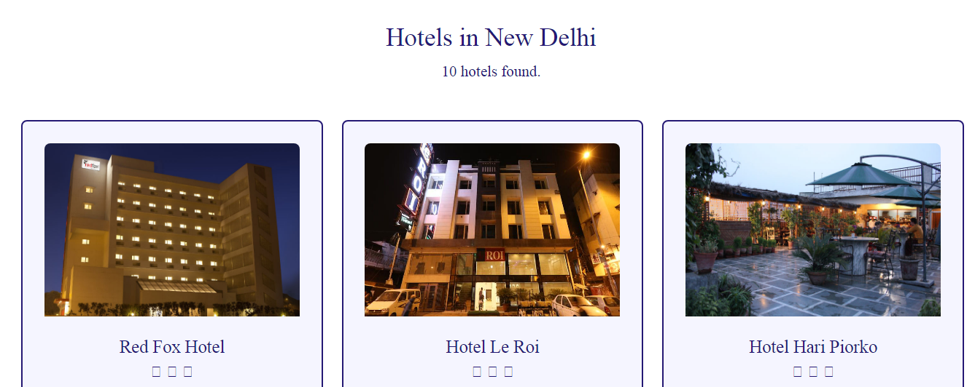
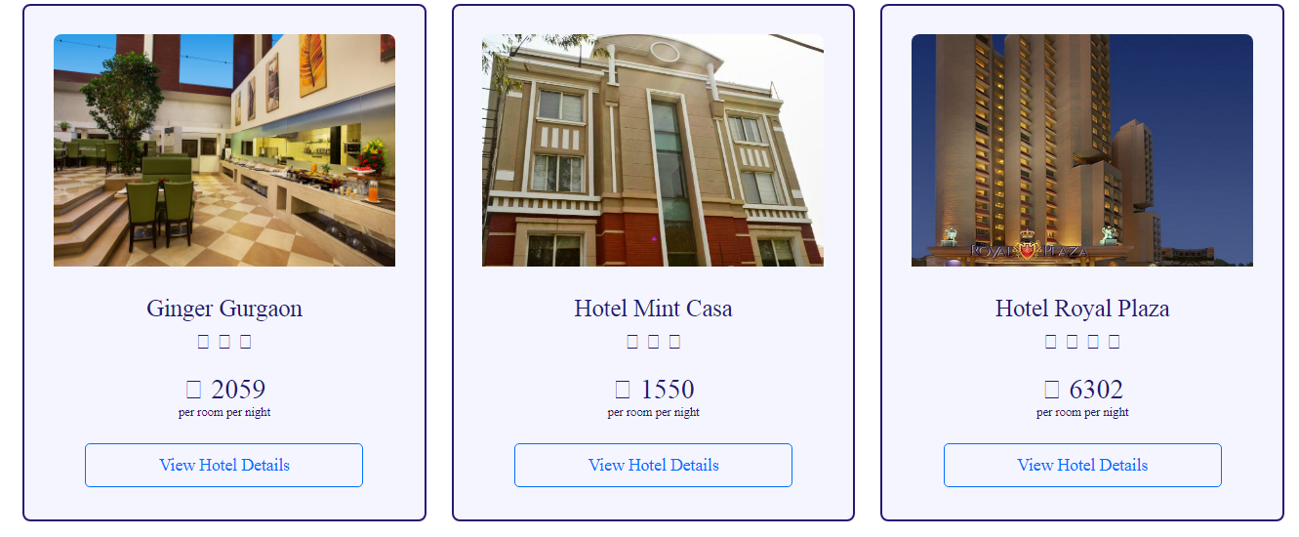
HOTELS AVAILABILITY AS PER SELECTED DESTINATION

Slide 46
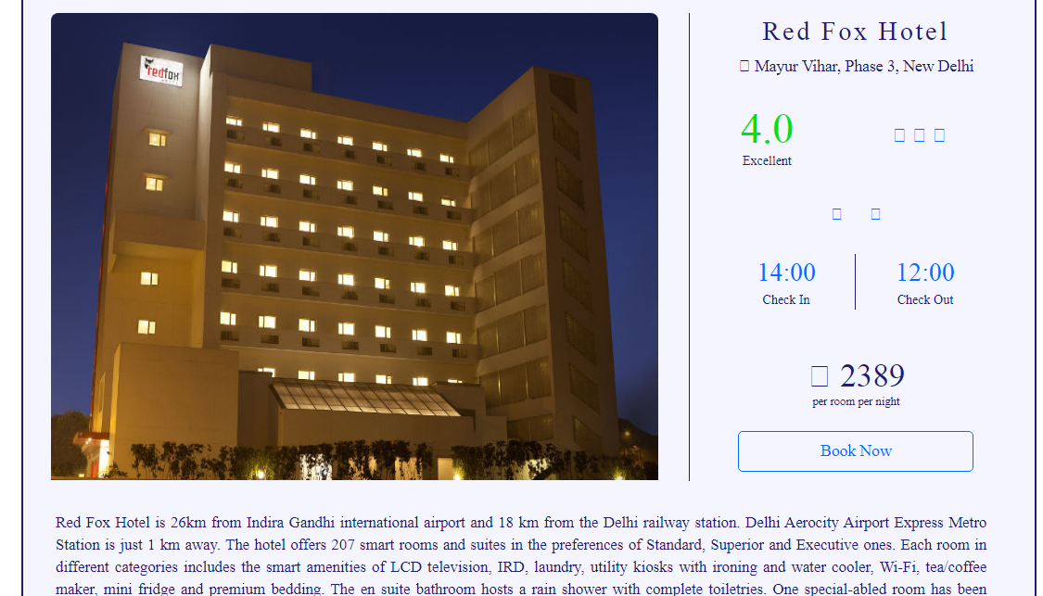
HOTEL DETAILS

Slide 47
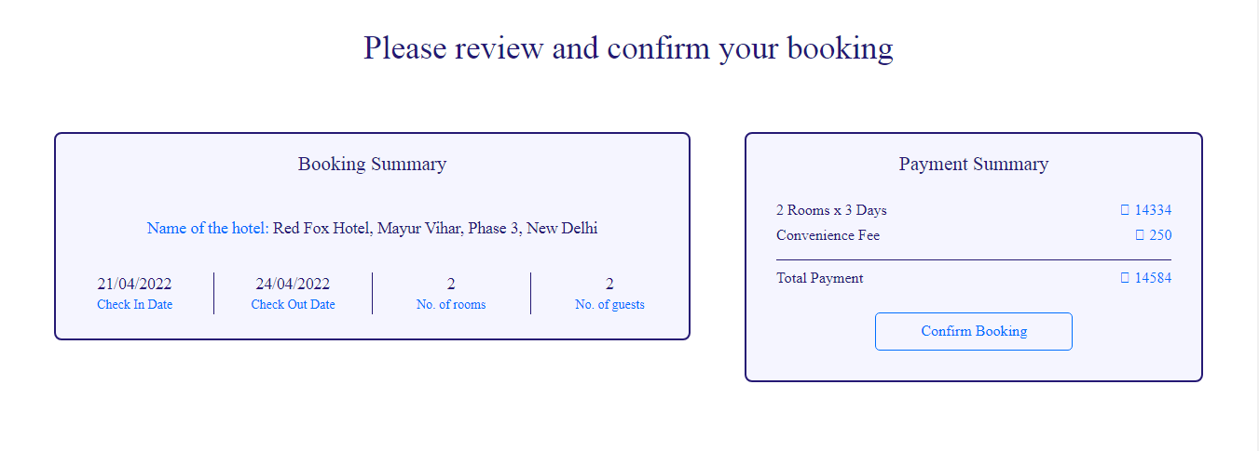
CONFIRM BOOKING PROCESS

Slide 48
PAYMENT PROCESS

Slide 49
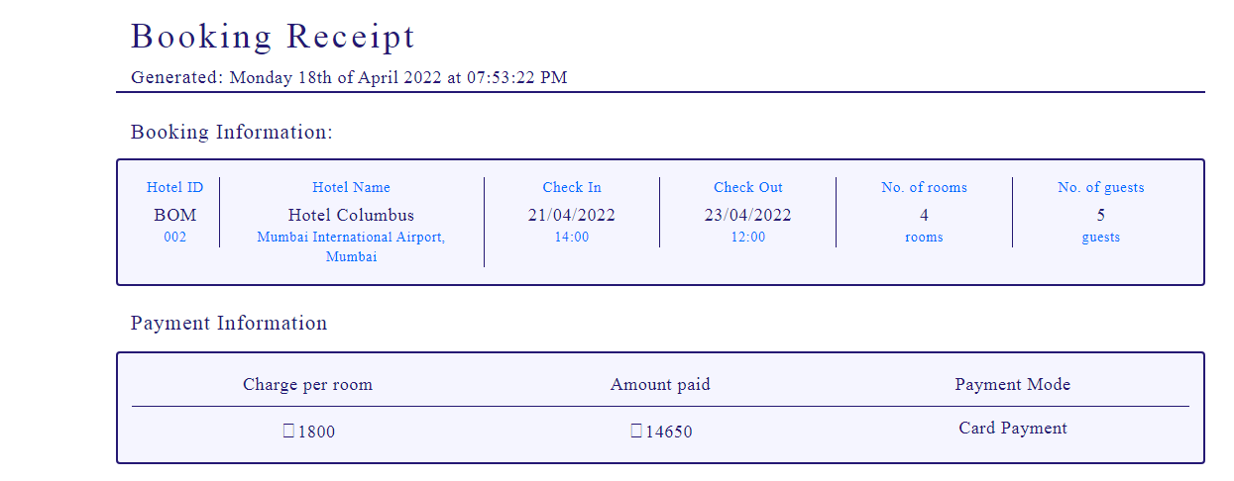
BOOKING RECEIPT

Slide 50
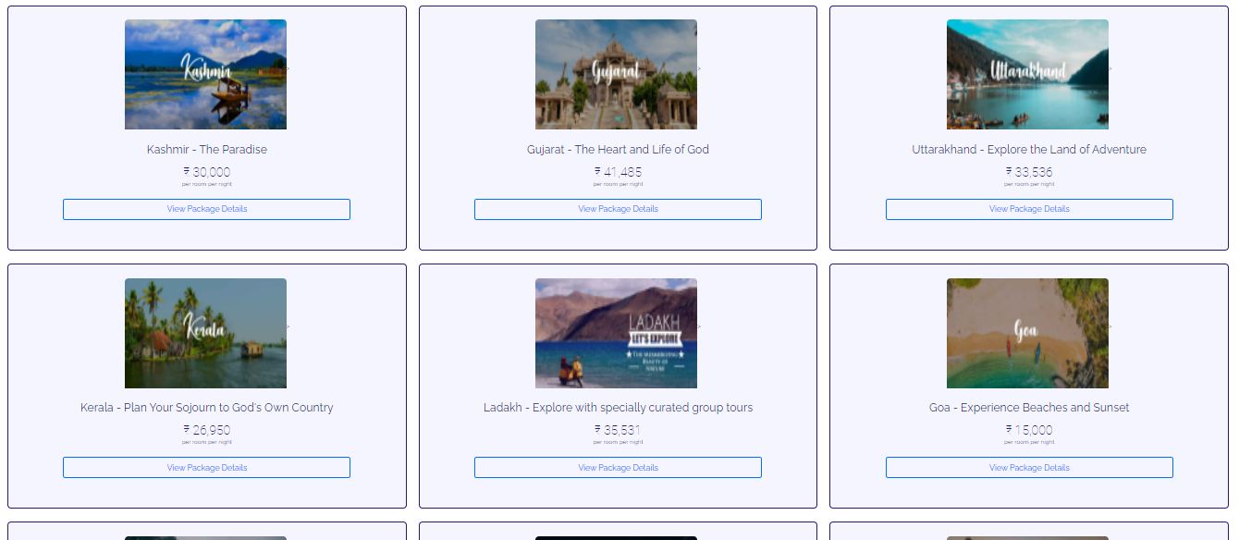
PACKAGE LIST

Slide 51
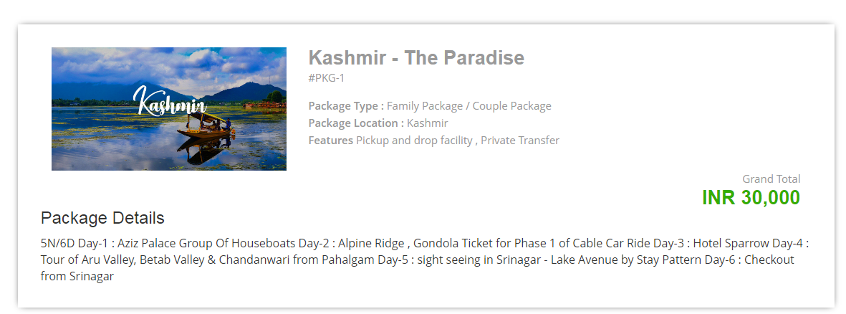
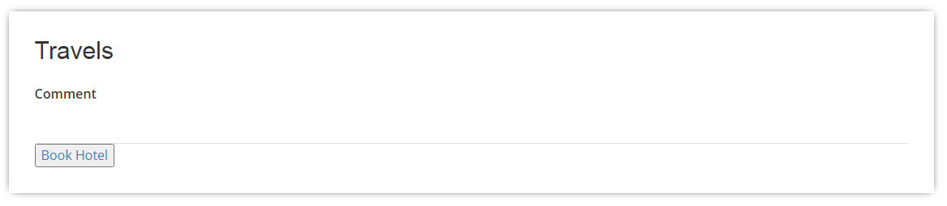
SELECTED PACKAGE DETAILS

Slide 52
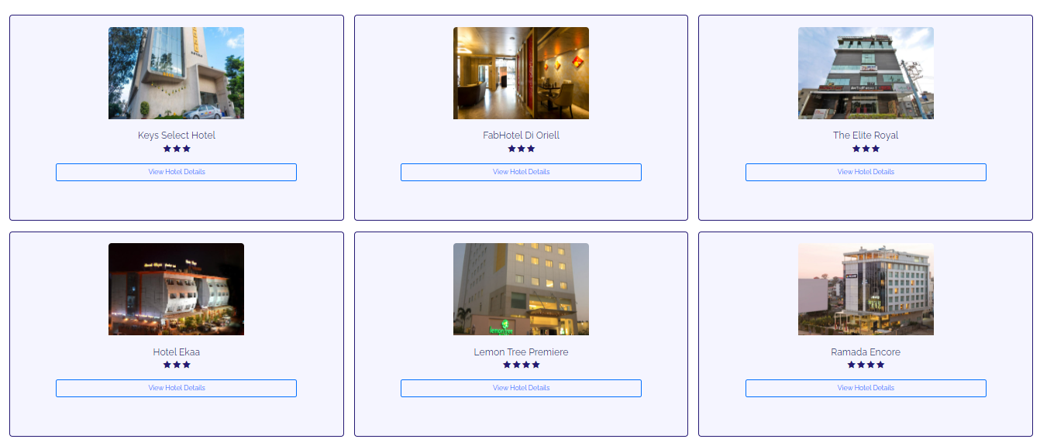
AVAILABILITY OF HOTELS WITH PACKAGES

Slide 53
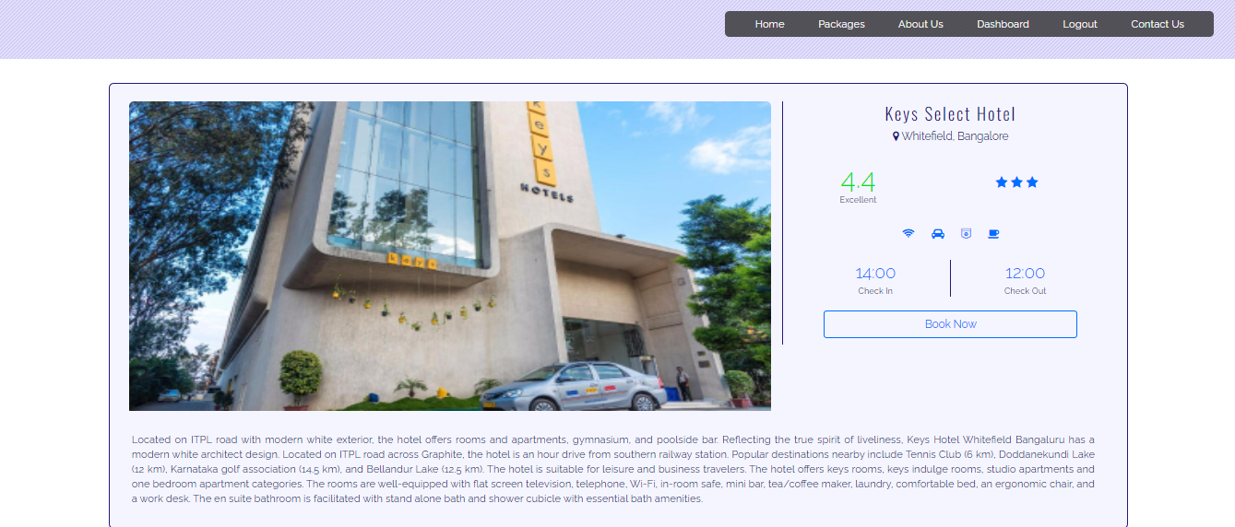
SELECTION OF HOTEL WITH PACKAGE

Slide 54
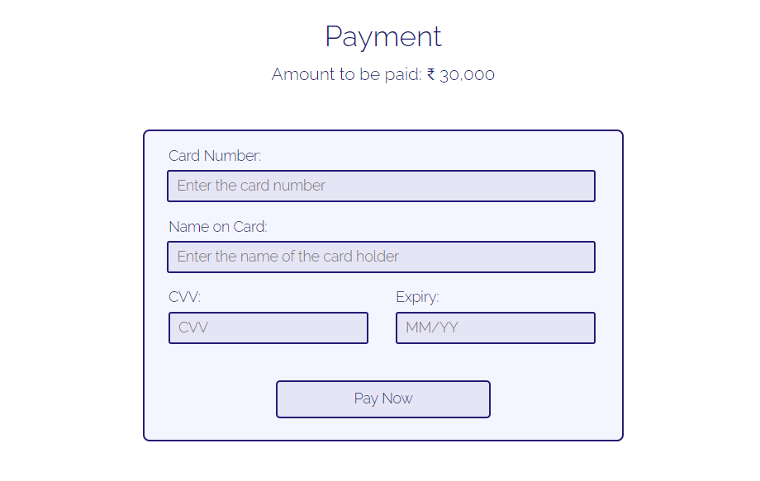
PAYMENT PROCESS

Slide 55
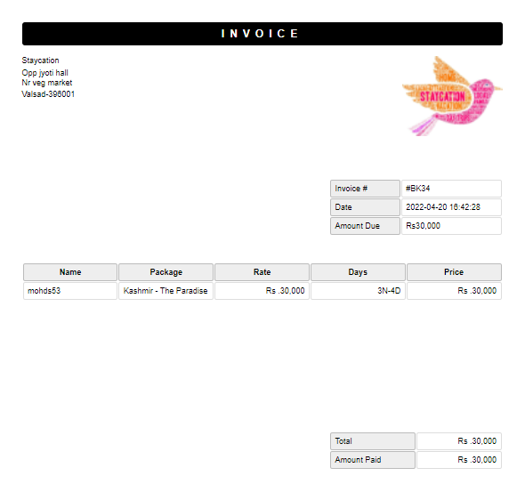
BOOKING RECEIPT

Slide 56
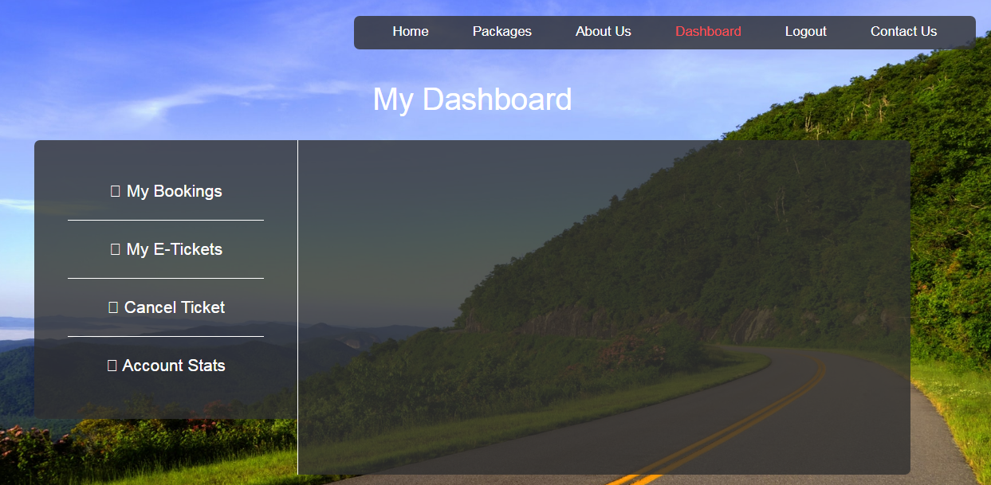
DASHBOARD PROFILE

Slide 57

MY BOOKINGS

Slide 58

MY E-TICKETS(FLIGHT TICKETS)

Slide 59

MY E-TICKETS(FLIGHT TICKETS)

Slide 60

CANCEL TICKET

Slide 61

ACCOUNT STATS

Slide 62

ADMIN LOGIN

Slide 63

ADMIN DASHBOARD

Slide 64

ADMIN ADD USERS

Slide 65

ADMIN UPDATE/DELETE/SEARCH USER

Slide 66

ADMIN VIEW USERS

Slide 67

ADMIN ADD PACKAGES

Slide 68

ADMIN VIEW PACKAGES

Slide 69

ADMIN PACKAGE BOOKINGS

Slide 70

ADMIN ADD HOTELS

Slide 71

ADMIN UPDATE/DELETE/SEARCH HOTELS

Slide 72

ADMIN VIEW HOTELS

Slide 73

ADMIN VIEW HOTEL BOOKINGS

Slide 74

ADMIN ADD FLIGHTS

Slide 75

ADMIN UPDATE/DELETE/SEARCH FLIGHTS

Slide 76

ADMIN VIEW FLIGHTS

Slide 77

ADMIN VIEW FLIGHTS BOOKINGS

Slide 78

ADMIN ADD TRAINS

Slide 79

ADMIN UPDATE/DELETE/SEARCH TRAINS

Slide 80

ADMIN VIEW TRAINS

Slide 81

ADMIN VIEW TRAIN BOOKINGS

Slide 82

ADMIN UPDATE PAGE(ABOUT US) THROUGH DATABASE

Slide 83

ABOUT US

Slide 84

CONTACT US

Slide 85
CONCLUSION
This website provides a computerized version of online tour booking for people
It makes the entire process online where customer can book their dream location online through online mode(staycation).
After booking user can also raise an issue about any technical inconvenience, then after admin receives it , sees it and replies back to the customer.
From a proper analysis of positive points and constraints on the component, it can be safely concluded that the product is a highly efficient GUI based component.
This application is working properly and meeting to all user requirements. This component can be easily plugged in many other systems.

Slide 86
FUTURE ENHANCEMENT
There is a future scope where customer can see a detailed GUI of website with some more payment mode.
And we are also planning to introduce EMI systems for our customers.
A feature of live chat(24/7) can be added for technical issue thus making it more interactive more user friendly and project which fulfills each users need in the best way possible.
We will be focusing more on tour packages.

Slide 87
REFERENCES
Book:
PHP & MYSQL
PHP Solution
Programming PHP
Website:
www.gurukul.com
www.w3schools.com
www.tutorialspoint.com

Slide 88
THANK YOU

